Slide 1
Performance Based
Report Cards
1-4 scale.
Developmentally Appropriate
Research Based
Provides students and parents with more detailed accurate information on individual student performance.
Grading in Pre-K -Second
Notes:
Points you may want to discuss:
-Shaded areas indicate that the tek has yet to be covered, however if it has been observed in a student then it may be assessed. In family access you will see a * (asterisk) to indicate that the tek has not been assessed at this point.
-Core Subjects will be reported by PK and K every 9 weeks AND by 1st and 2nd grades every 3 weeks.
-Art, Health, PE, Technology, Music,, Student Responsibilities (LIM) will be reported every 9 weeks
-Most work that goes home will have a 1-4 score.

Slide 2
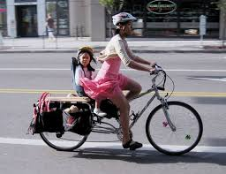
Level 1-Beginning
Student needs direct support to be successful with the current skill or concept at this time
Student may be lacking the basic knowledge/skills necessary to analyze, apply, synthesize or evaluate at this time
Grading in Pre-K -Second
Notes:
I do not understand the skill

Slide 3
Level 2-Developing
Student needs minimal support to be successful with the current skill or concept at this time
Student is gaining knowledge and skills necessary to analyze, apply, synthesize or evaluate the concept or skill
Student may be independent sometimes but still needs support.
Grading in Pre-K -Second
Notes:
I understand the skill with little help.

Slide 4
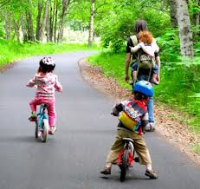
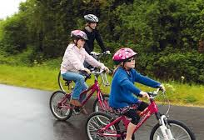
Level 3-Secure
Student is secure with the skill or concept. Student works independently and is successful on a regular basis with the current skill or concept at this time
Student meets the minimum knowledge and comprehension level of the standard.
Student may begin to analyze new information based upon a basic set of knowledge/skills and can apply information/skills to new settings
Grading in Pre-K -Second
Notes:
I understand the skill and can work independently.

Slide 5
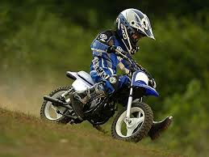
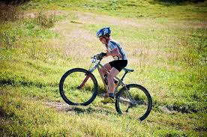
Level 4-Extending
Student is secure with the skill or concept. Student works independently to apply what he/she has learned to new situations
Student can analyze new information based upon a basic set of knowledge/skills and can apply information/skills in new settings
Grading in Pre-K -Second
Notes:
I get it and I can explain and teach others. Level 4 work would indicate a much deeper
understanding of a standard, the ability to apply that knowledge, make connections and extend learning beyond the targeted goal.

Slide 6
Level 1-Beginning
Level 2-Developing
Grading in Pre-K -Second
Level 3-Secure
Level 4-Extending
Notes:
Level 1 - Beginning = “I do not understand the skill” Student needs direct support to be successful with the current skill or concept at this time
Student may be lacking the basic knowledge/skills necessary to analyze, apply, synthesize or evaluate at this time
Level 2 - Developing = “I understand the skill with little help.” Student needs minimal support to be successful with the current skill or concept at this time
Student is gaining knowledge and skills necessary to analyze, apply, synthesize or evaluate the concept or skill
Student may be independent sometimes but still needs support.
Level 3 - Secure = “I understand the skill and can work independently.”
Student is secure with the skill or concept. Student works independently and is successful on a regular basis with the current skill or concept at this time
Student meets the minimum knowledge and comprehension level of the standard.
Student may begin to analyze new information based upon a basic set of knowledge/skills and can apply information/skills to new settings
Level 4 - Extending = “I get it and I can explain and teach others.” Level 4 work would indicate a much deeper
understanding of a standard, the ability to apply that knowledge, make connections and extend learning beyond the targeted goal.
Student is secure with the skill or concept. Student works independently to apply what he/she has learned to new situations
Student can analyze new information based upon a basic set of knowledge/skills and can apply information/skills in new settings

Slide 7
Level 1-Beginning
Level 2-Developing
Grading in Pre-K -Second
Level 3-Secure
Level 4-Extending
Notes:
Level 1 - Beginning = “I do not understand the skill” Student needs direct support to be successful with the current skill or concept at this time
Student may be lacking the basic knowledge/skills necessary to analyze, apply, synthesize or evaluate at this time
Level 2 - Developing = “I understand the skill with little help.” Student needs minimal support to be successful with the current skill or concept at this time
Student is gaining knowledge and skills necessary to analyze, apply, synthesize or evaluate the concept or skill
Student may be independent sometimes but still needs support.
Level 3 - Secure = “I understand the skill and can work independently.”
Student is secure with the skill or concept. Student works independently and is successful on a regular basis with the current skill or concept at this time
Student meets the minimum knowledge and comprehension level of the standard.
Student may begin to analyze new information based upon a basic set of knowledge/skills and can apply information/skills to new settings
Level 4 - Extending = “I get it and I can explain and teach others.” Level 4 work would indicate a much deeper
understanding of a standard, the ability to apply that knowledge, make connections and extend learning beyond the targeted goal.
Student is secure with the skill or concept. Student works independently to apply what he/she has learned to new situations
Student can analyze new information based upon a basic set of knowledge/skills and can apply information/skills in new settings

